Slide 1


Prediction of Cardiovascular Disease risk by use of Multiple Risk Factors in Adults aged 30–50 years.
SAT 5424 FINAL PROJECT
Ifunanya Ezeumeh, Sifat Naseem, Naomi Sang, and Kimaya Havle.

Slide 2

Why CVD prediction?
Cardiovascular diseases (CVDs) are the leading cause of death worldwide, with an estimated 17.9 million deaths in 2019, accounting for 32% of all global deaths.^{[9]}
Population-based prevention strategies and improved detection and treatment of high-risk individuals are needed to reduce the future burden of CVD.
Awareness on CVD in younger populations is less than ideal. Interventions that target access to health information, via health promotion, may increase awareness and facilitate achieving treatment goals in young adults.^{[4]}

Slide 3
Justification of population selected
Target study population is adults between 30 and 50 years of age
Total of 21,314 individuals with 13,393 women and 7,921 men
The prediction is based on 11 features and a target variable value of absence or presence of cardiovascular disease (CVD)
The focus of this study is to investigate the increasing risk of CVD diagnosis in younger populations.

Slide 4
Justification of the methods used
We selected 6 machine learning models that were most frequently used to predict CVDs throughout the papers we refer to.
They all have the strength of identifying complex, non-linear relationships in the data and interactions between different predictors.
Individual strengths include; improved prediction accuracy, minimized data overfitting, accurate feature selection and improved sensitivity and specificity.

Slide 5
Literature review
CVD dataset contains objective, examined and subjective features. ^{[10]}
Proper and timely diagnosis of CVD requires systems that predict with precise accuracy and reliability.^{[9]}
Use of machine learning (ML) on the large quantities of healthcare data to form judgements, create predictions and support clinical decision making based, is highly valuable.^{[5]}
Different ML algorithms are being used for classification and prediction targets but no standard has been developed to guide the selection of specific algorithms for clinical use in cardiovascular medicine.^{[2]}

Slide 6
How literature influenced our project
Informed the selection of models used
Justified the selection of our project problem
Informed the need for CVD risk identification in younger populations.
Narrowed down on the optimal models as results were consistent with some of the works referred to in the project

Slide 7
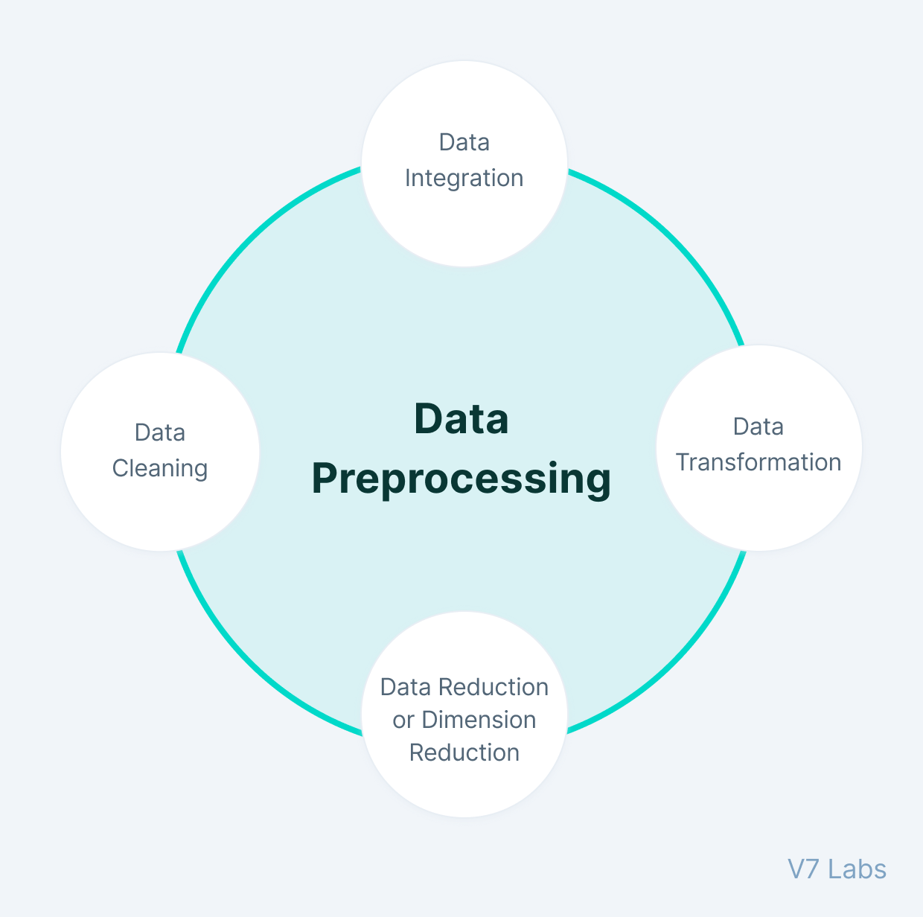
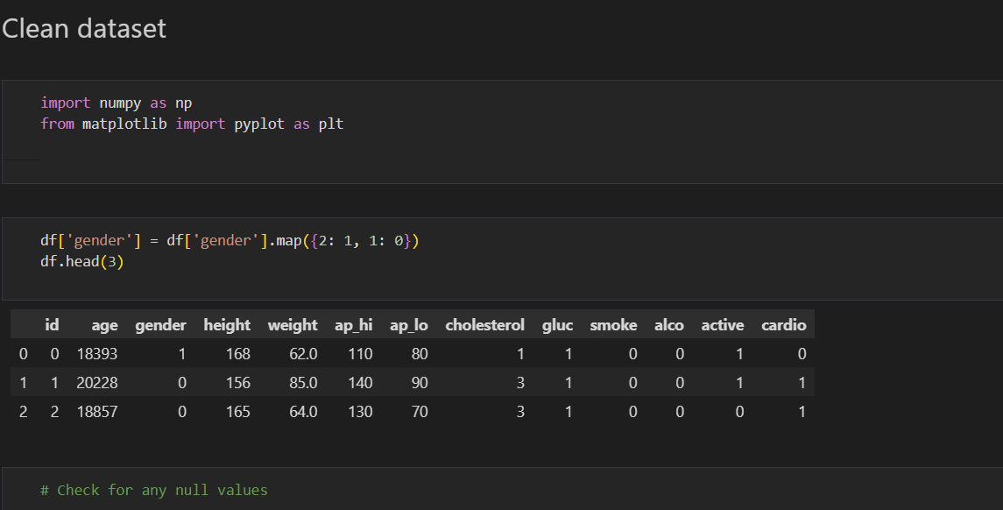
Data Pre-Processing

Slide 8
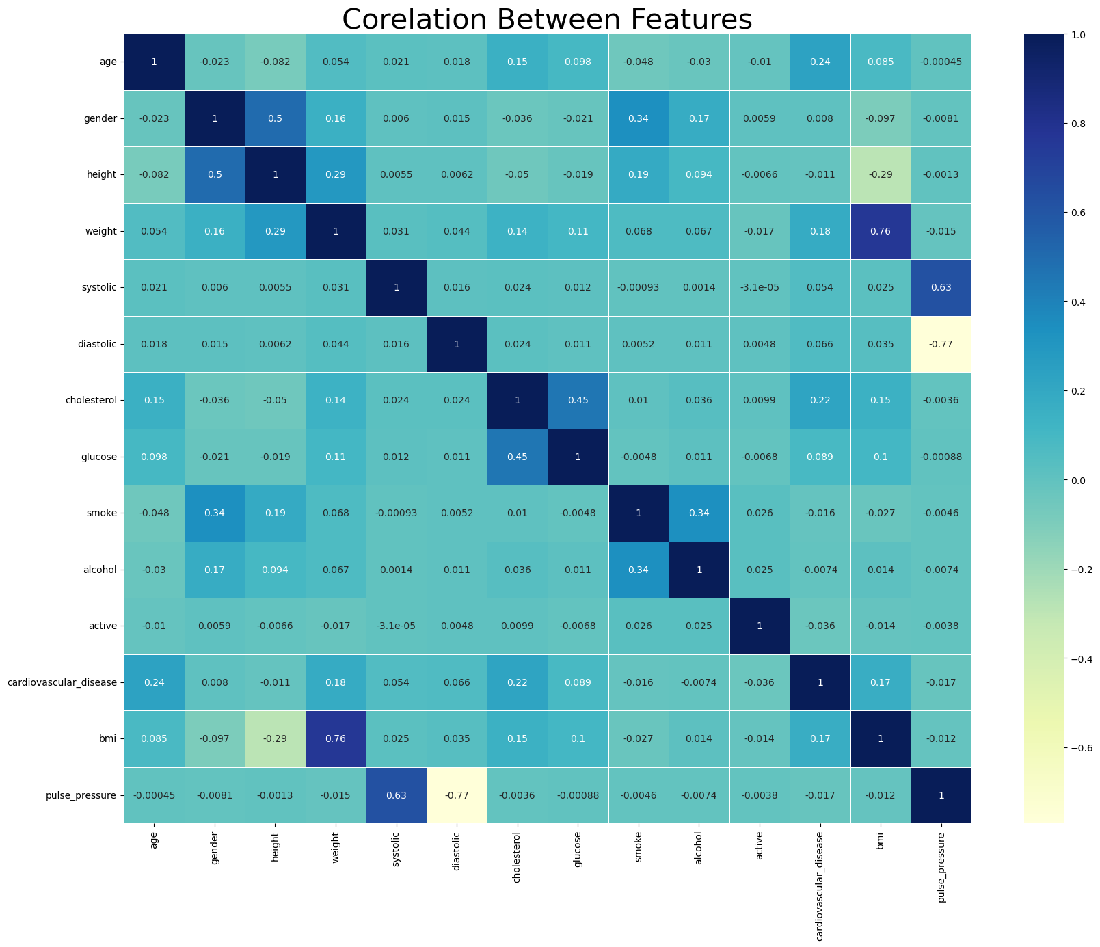
Correlation Graph

Slide 9
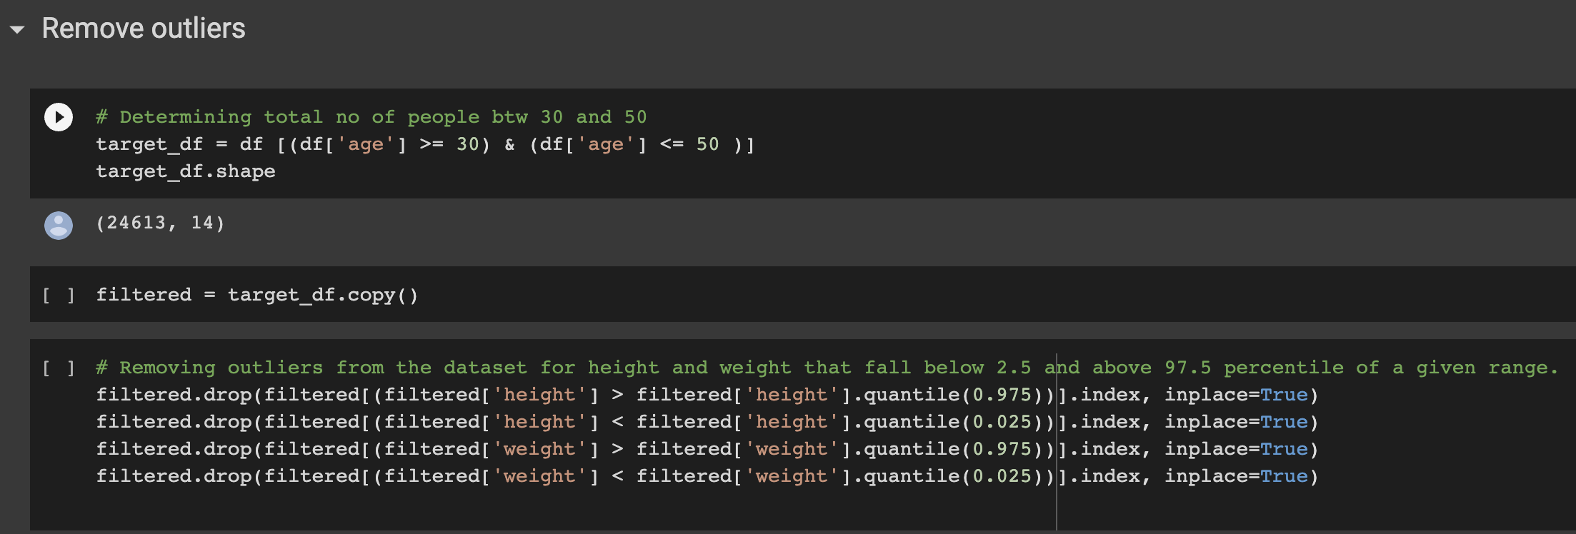
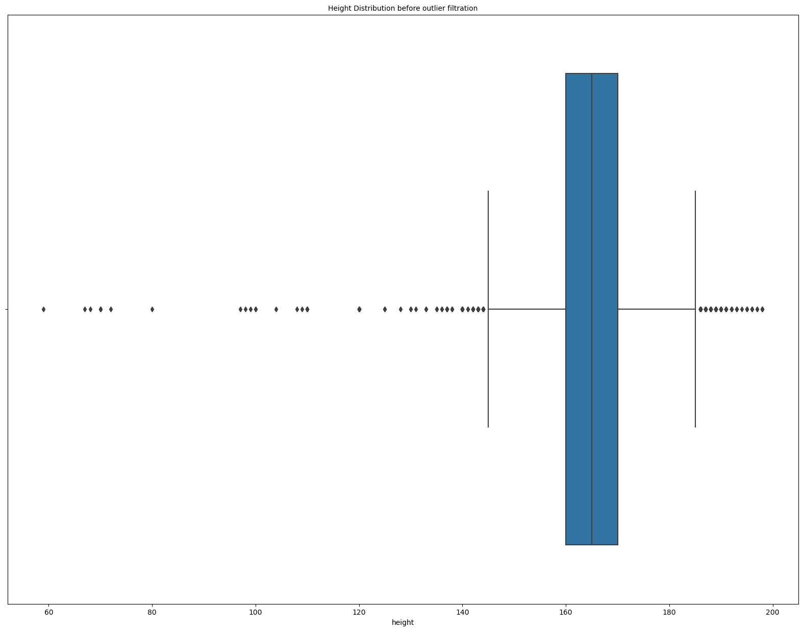
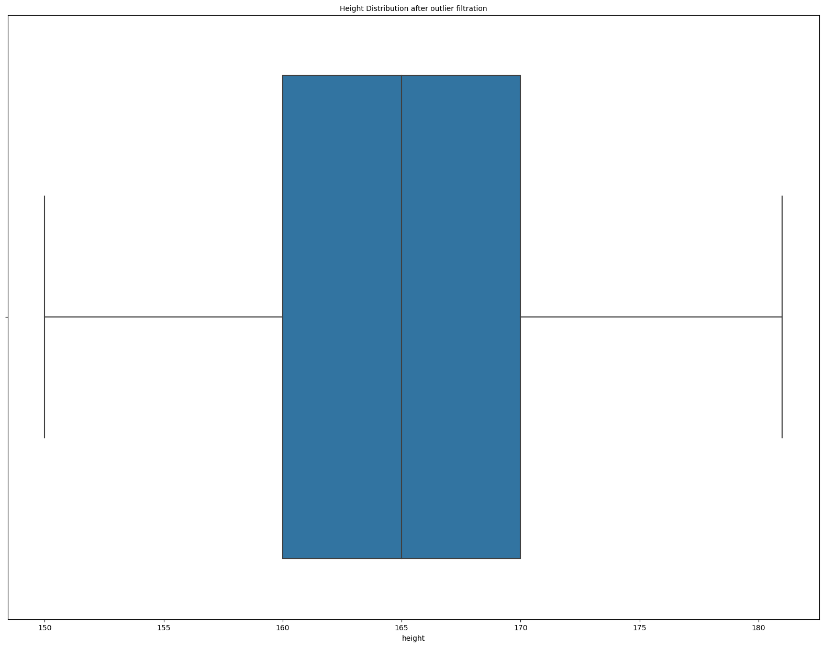
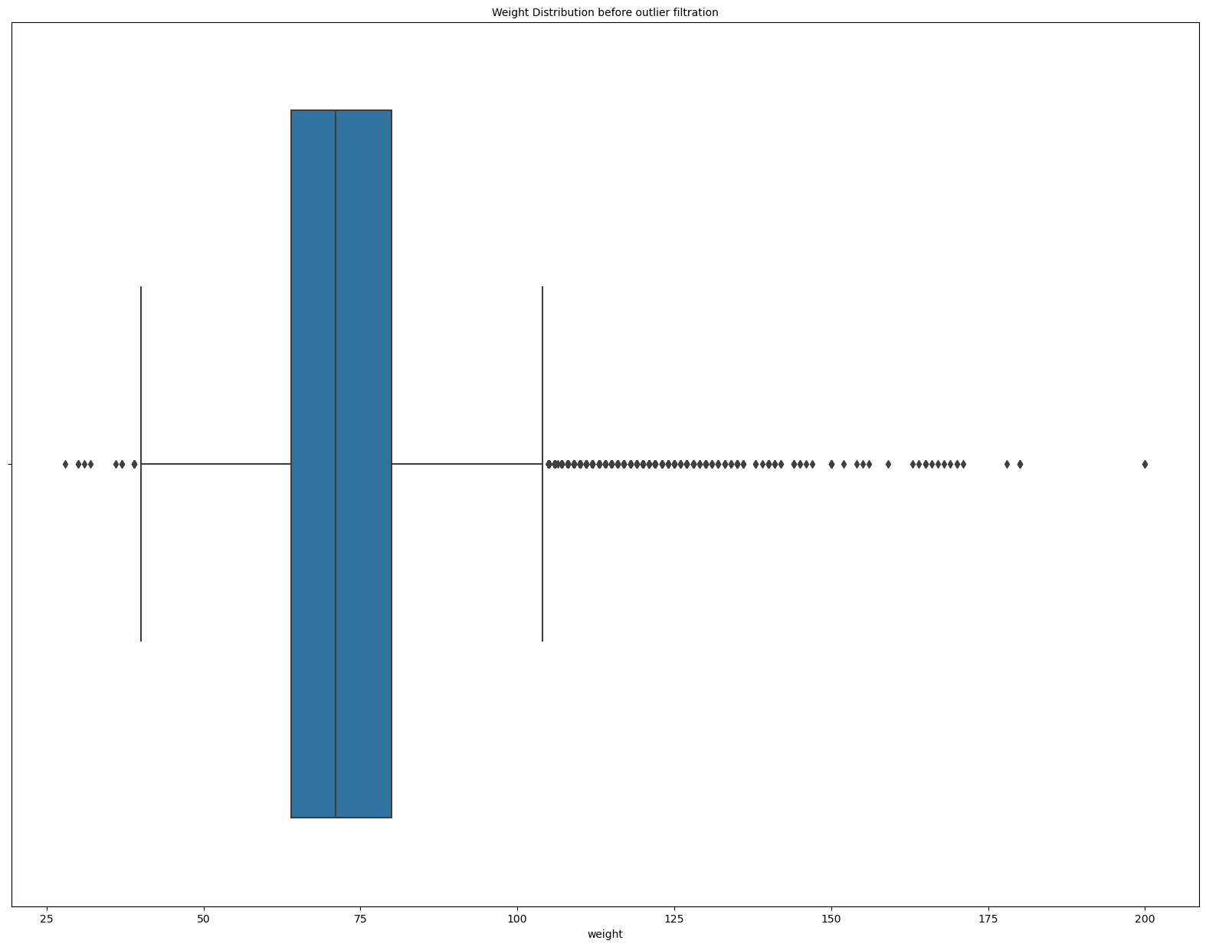
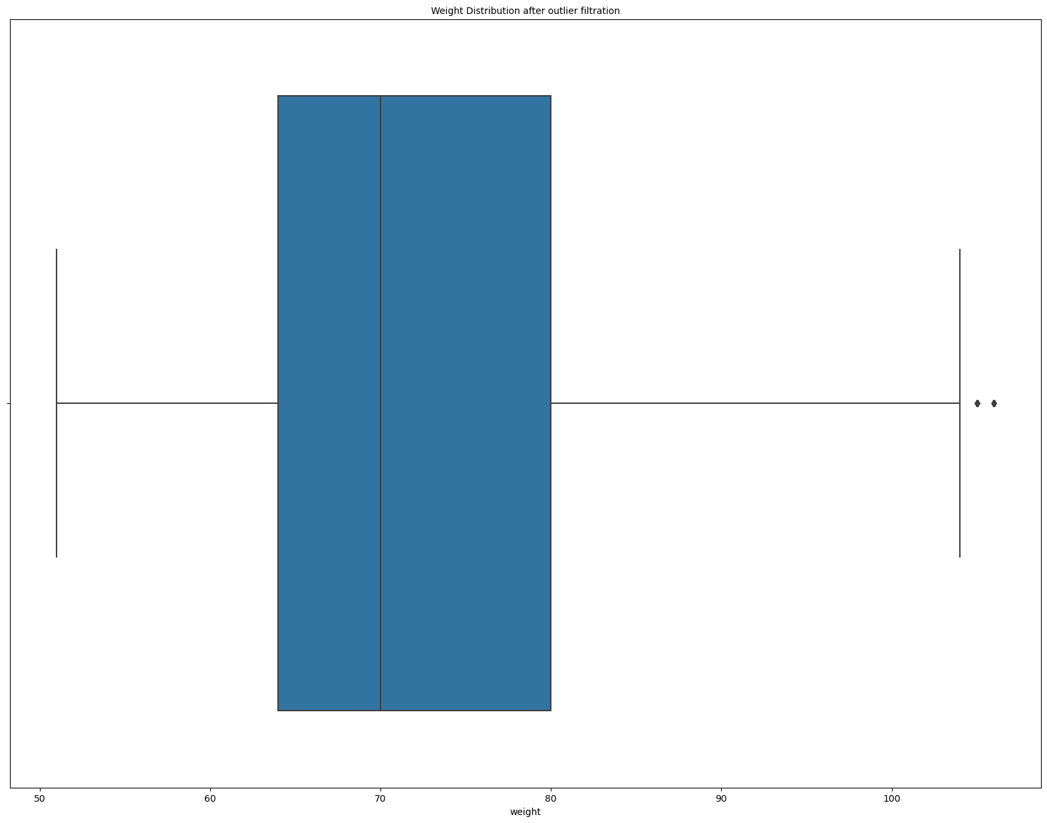
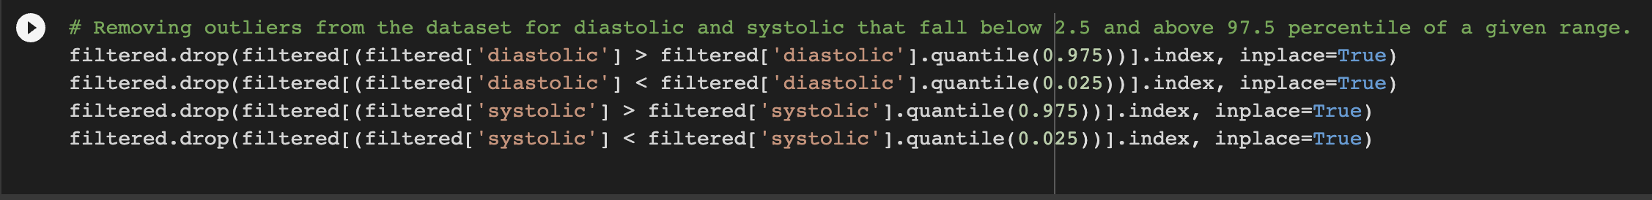
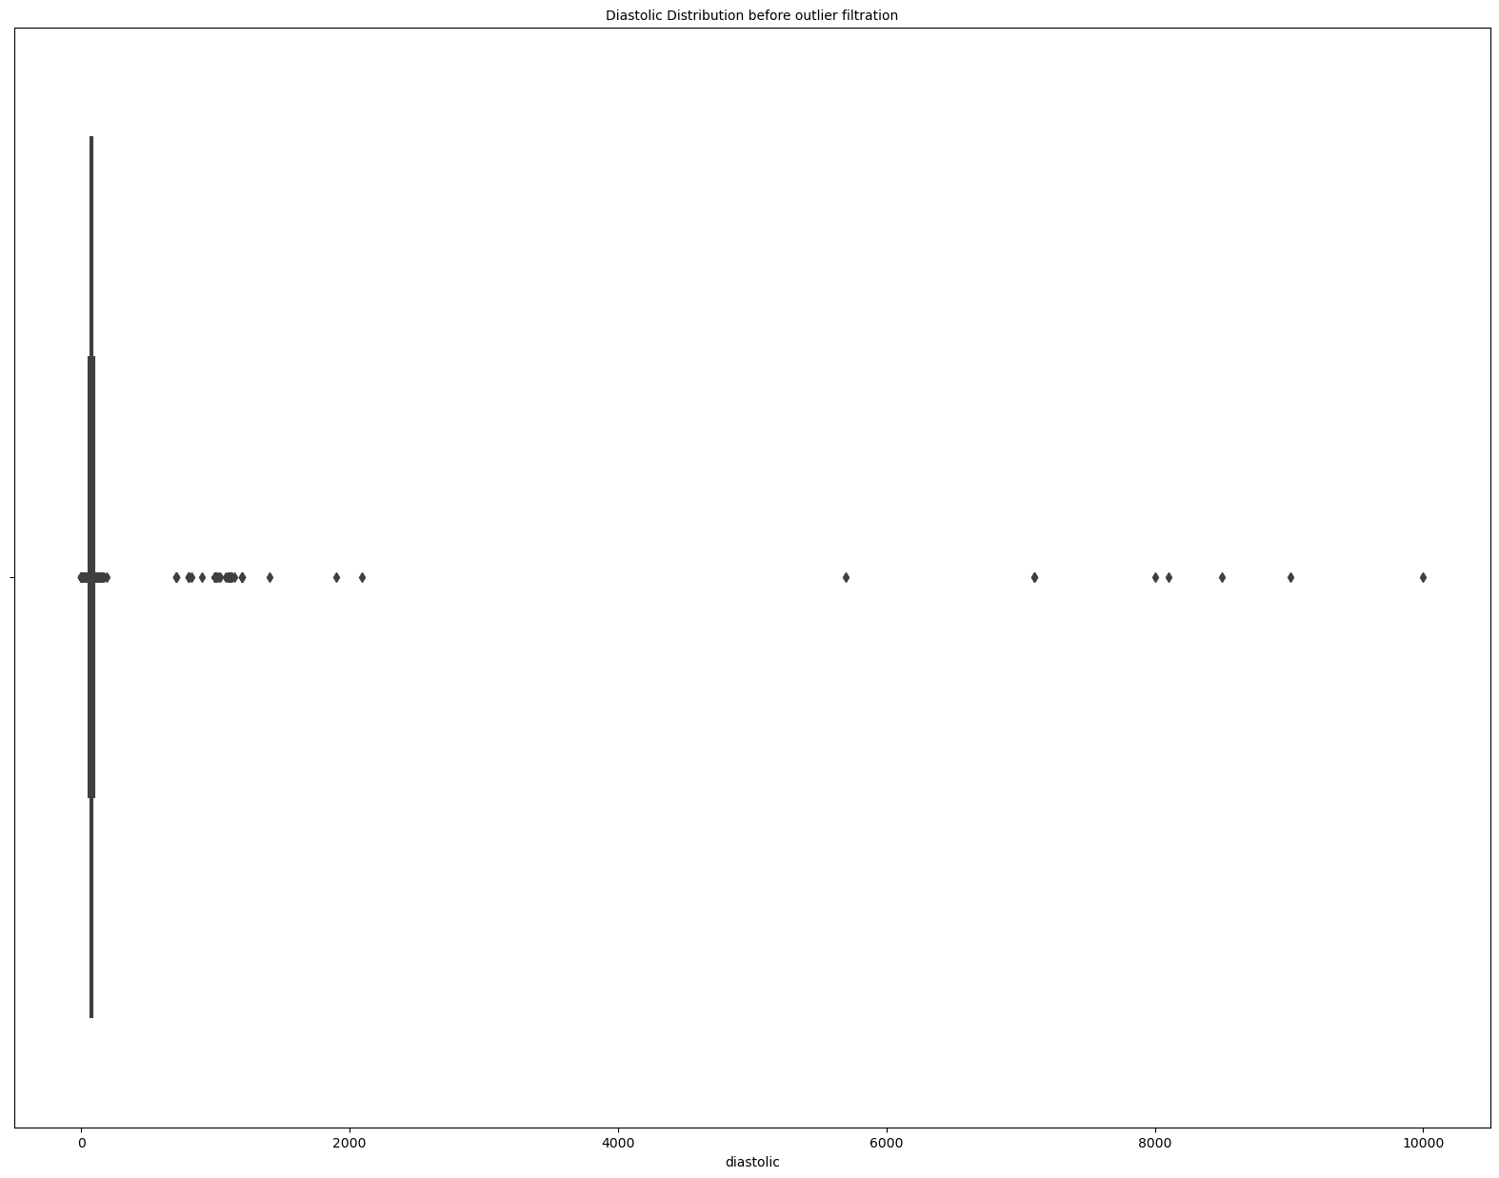
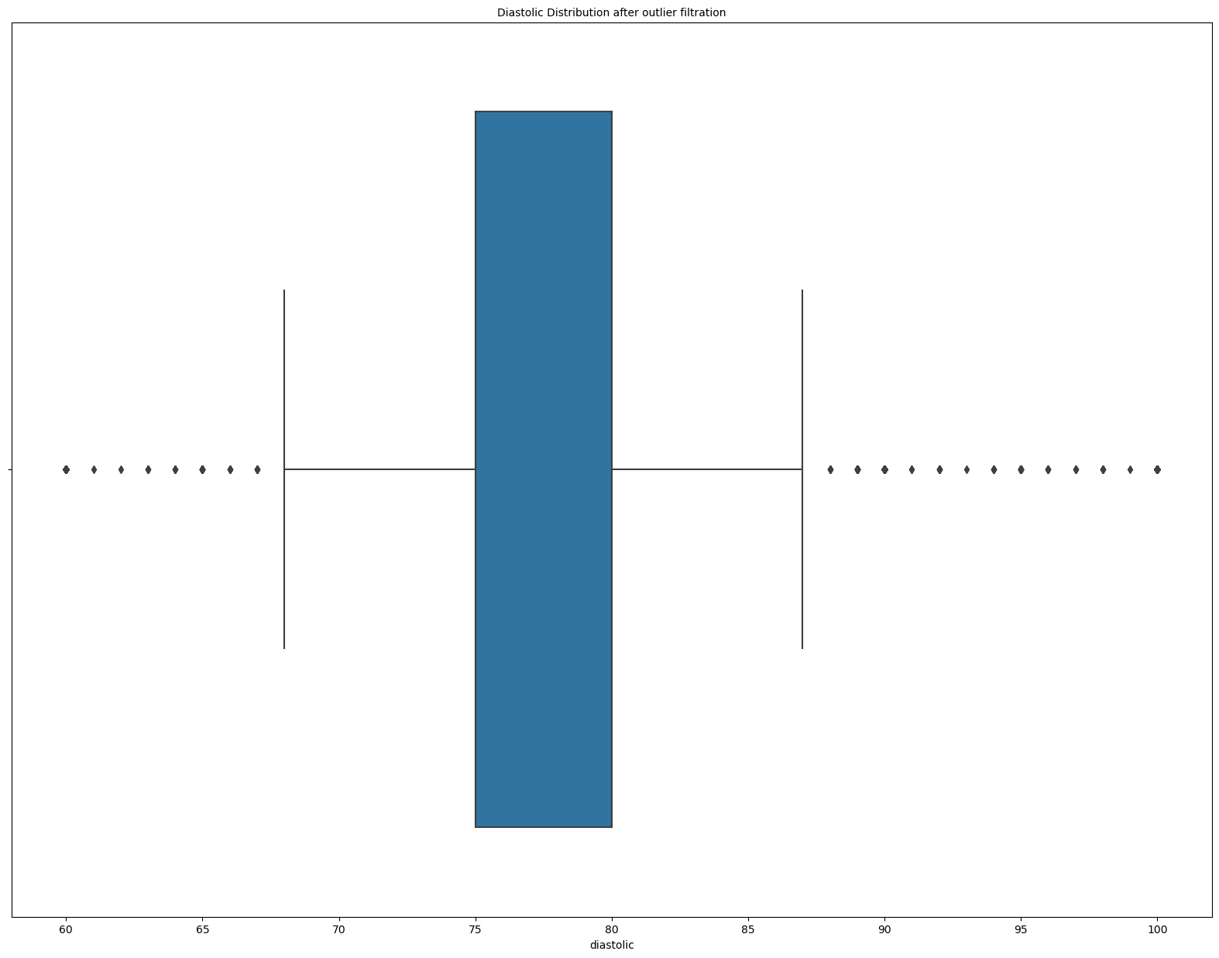
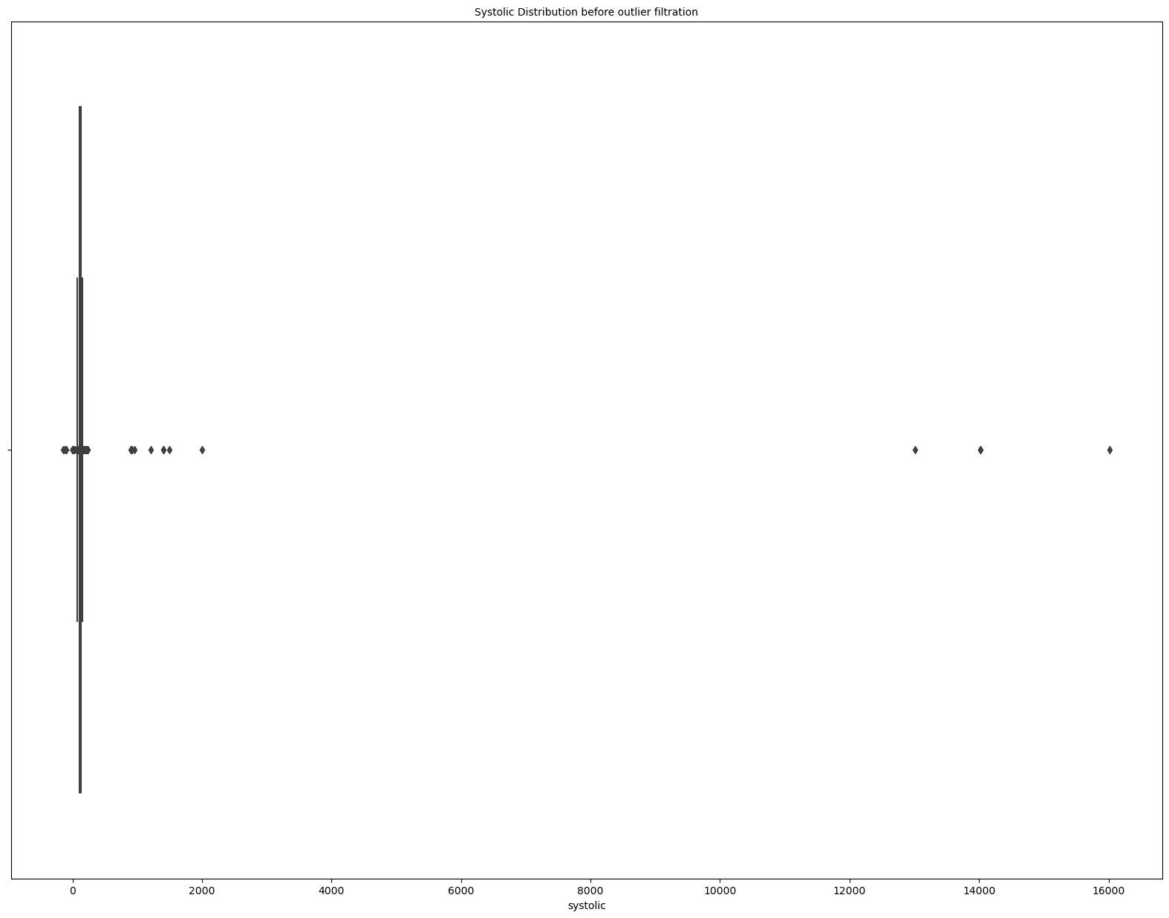

Removing Outliers-

Slide 10
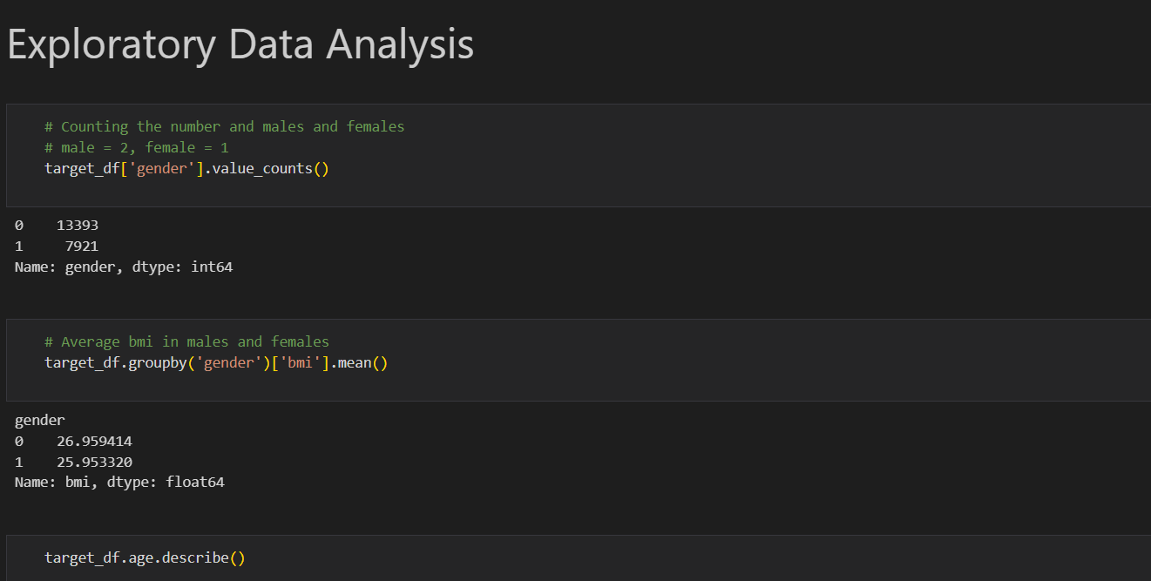


Slide 11
What are the methods used?
MODEL | ACCURACY | F1 score
Random forest | 79% | 64%
AdaBoost | 78% | 66%
Logistic Regression | 78% | 63%
MLP | 73% | 66%
SVM | 77% | 60%
eXtreme Gradient Boosting | 79% | 66%

Slide 12
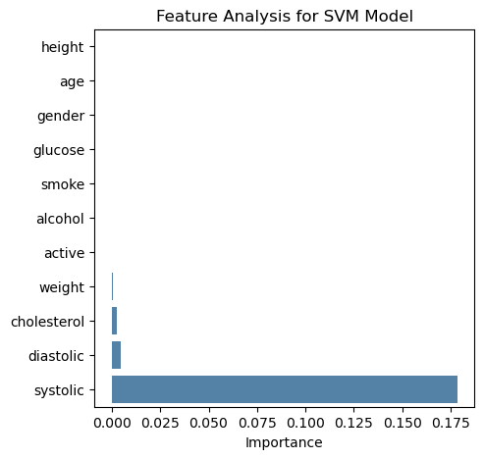
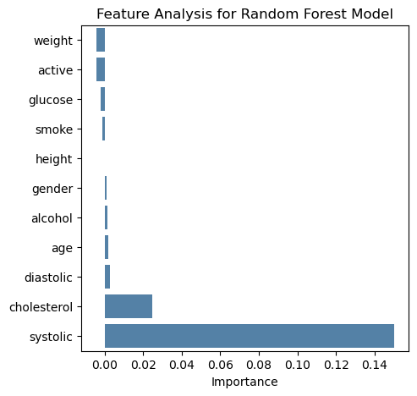
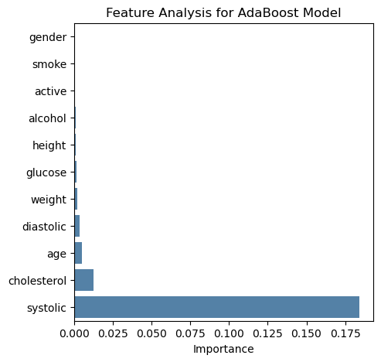
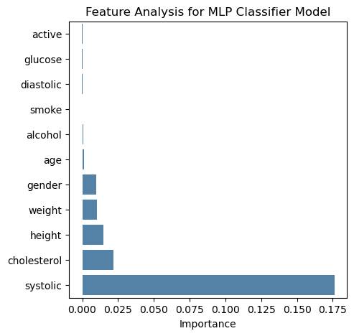
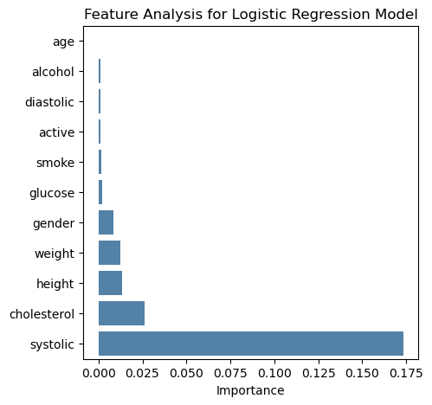
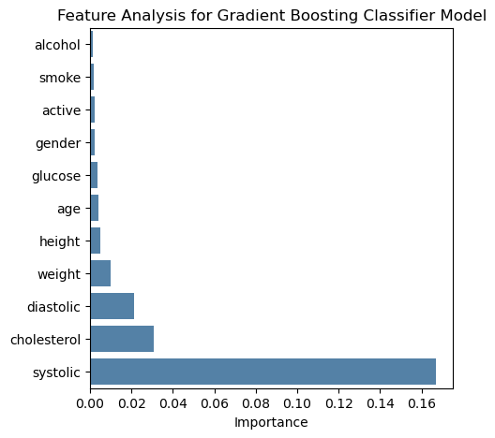
Feature Analysis

Slide 13
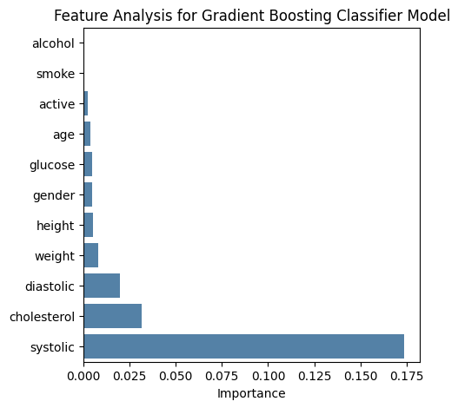
What algorithm model was optimal?
XGBoost is our most optimal model
Accuracy- 79
F-1 score- 0.66
Best Feature- Systolic BP, Cholesterol
It uses multiple weak predictors to give a strong predictions
Good prediction power for classification problems

Slide 14
What other tools could we have used?
Deep learning models
Require large datasets to be effectively trained.
Dataset is low dimensional.
It is a simple classification task and a deep learning model will be too complex.
Computationally expensive.

Slide 15
Strengths of the dataset
High interpretability.
Computationally inexpensive to train an ML model.

Slide 16
Weaknesses of the dataset
Dataset has only 11 features which is makes it low dimensional.
Does not contain any radiology images hence unable to conduct CNN to support CVD prediction.
Though alcohol and smoking have a strong correlation in CVD prediction, this dataset couldn't justify the correlation.
The features used for prediction do not factor in key younger population risk predictors like alcohol consumption.

Slide 17
Limitations of the Study
There are no peer-reviewed studies carried out on our dataset and target population, so we have no studies to compare our model performance to.
Inadequate computational resources to try more complex models.

Slide 18
Severity & Risk Adjustment
Severity: Aids early detection and interrupt disease progression.
Risk adjustment: Lifestyle changes to reduce risk.

Slide 19
Conclusions on the Project Findings
For this dataset, XGBoost has the highest accuracy and F1 score of 78.9% and 0.66 respectively
Based on feature correlation and analysis, body weight, systolic pressure and cholesterol are the highest contributing predictors of CVD.
Data for alcohol drinking and smoking should be collected in younger populations to accurately access their risk of being diagnosed with CVD.

Slide 20
Recommendations to improve our measures
Use of a dataset that focuses more on the target population age group.
Find a larger dataset, with more predictors, to perform deep learning analysis
Obtain a dataset that is geographically diverse with the support of GIS
Include social determinations of health as features for CVD prediction.
Combining the ML models to yield better perfomance.

Slide 21
How feasible are the recommendations?
Obtaining data from Governmental and NGOs through website can be feasible.
However, obtaining geographic and information on social determinants of health of the participants would require multiple stakeholder involvement due to legal and ethical requirements.

Slide 22
References
Rajliwall NS, Davey R, Chetty G. Cardiovascular risk prediction based on XGBoost: Semantic scholar [Internet]. 2018 5th Asia-Pacific World Congress on Computer Science and Engineering (APWC on CSE). 1970 [cited. Available
Surjeet Dalal, Pallavi Goel, Edeh Michael Onyema, Adnan Alharbi, Amena Mahmoud, Majed A. Algarni, Halifa Awal, "Application of Machine Learning for Cardiovascular Disease Risk Prediction", Computational Intelligence and Neuroscience, vol. 2023, Article ID 9418666, 12 pages, 2023. Available
Pallivalappil A, Das S, Subramanian M, G K. Artificial Intelligence Ensemble Methods for Cardiovascular Disease Prediction [Internet]. NASA/ADS. Available
Bucholz EM, Gooding HC, de Ferranti SD. Awareness of Cardiovascular Risk Factors in U.S. Young Adults Aged 18-39 Years. Am J Prev Med. 2018 Apr;54(4):e67-e77. doi: 10.1016/j.amepre.2018.01.022. Epub 2018 Feb 9. PMID: 29433955; PMCID: PMC5893222. Available
Vardhan Shorewala. Early detection of coronary heart disease using ensemble techniques, Informatics in Medicine Unlocked, Volume 26, 2021, 100655, ISSN 2352-9148. Available

Slide 23
References
6. Heart disease prediction using artificial intelligence ensemble network [Internet]. Available
7. Gender Differences in the Epidemiology of Alcohol Use and Related Harms in the United States White AM. Gender Differences in the Epidemiology of Alcohol Use and Related Harms in the United States. Alcohol Res. 2020 Oct 29;40(2):01. doi: 10.35946/arcr.v40.2.01. PMID: 33133878; PMCID: PMC7590834. Available
8. Clark CJ, Alonso A, Spencer RA, Pencina M, Williams K, Everson-Rose SA. Predicted long-term cardiovascular risk among young adults in the national longitudinal study of adolescent health. Am J Public Health. 2014 Dec;104(12):e108-15. doi: 10.2105/AJPH.2014.302148. Epub 2014 Oct 16. PMID: 25322295; PMCID: PMC4232148. Available
9. Syed Nawaz Pasha, Dadi Ramesh, Sallauddin Mohmmad, A. Harshavardhan and Shabana. Cardiovascular disease prediction using deep learning techniques. Published under license by IOP Publishing Ltd. doi: 10.1088/1757-899X/981/2/022006. Available

Slide 24
References
10. World Health Organization Cardiovascular diseases(CVDs)Factsheet. Available
11. Cardiovascular Disease Dataset. Available
12. Cardiovascular disease prediction using deep learning techniques. Available

